Slide 1
DTSA 5011 Introduction to Deep Learning Final Project
Experiments with Model Architecture using the MNIST Digits Data Set

Slide 2
Experiments Comparing Architectures Classifying MNIST Digits dataset.
Dense Models
No Hidden Layer
1, 2, 3 or 4 Hidden Layers
64, 128, or 192 units in each hidden layer
Optimizer/Dropout
SGD
Adam
Adam with Dropout Layers
CNN Models
4 Versions

Slide 3
Dense Model Results
Baseline model Test Accuracy 0.922
Test Accuracy between 0.966 and 0.980 for all deeper models
Much wider spread in training time 10.6 seconds to 312 seconds

Slide 4
And The Winner Is ...
Dense Model with Best Accuracy
0.9803 with 1 hidden layer of 192 units, Adam Optimizer
Dense Model with Shortest Training Time
10.6 sec with 2 hidden layers of 192 units, Adam Optimizer

Slide 5
CNN Model 1 from Deep Learning with Tensorflow2 and Keras
model = models.Sequential()
# CONV => RELU => POOL
model.add(layers.Convolution2D(20, (5, 5), activation='relu',
input_shape=INPUT_SHAPE))
model.add(layers.MaxPooling2D(pool_size=(2, 2), strides=(2, 2)))
# CONV => RELU => POOL
model.add(layers.Convolution2D(50, (5, 5), activation='relu'))
model.add(layers.MaxPooling2D(pool_size=(2, 2), strides=(2, 2)))
# Flatten => RELU layers
model.add(layers.Flatten())
model.add(layers.Dense(500, activation='relu'))
# a softmax classifier
model.add(layers.Dense(DIGIT_CLASSES, activation="softmax"))

Slide 6
CNN Models 2, 3, and 4
Model 2, replaced 2 (5,5) kernel convolution layers with 2 (3,3) kernel layers
Model 3, like Model 2, but added a third (3,3) kernel convolution layer
Model 4, starting from Model 1, replaced each (5,5) kernel convolution layer with two (3,3) kernel layers

Slide 7
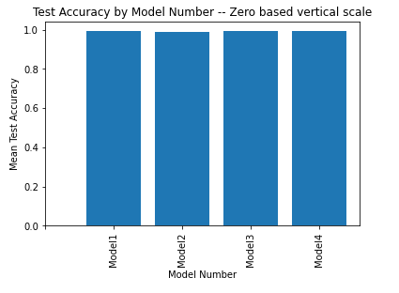
CNN Model Comparison
all 4 models test accuracy between 0.9904 and 0.9913

Slide 8
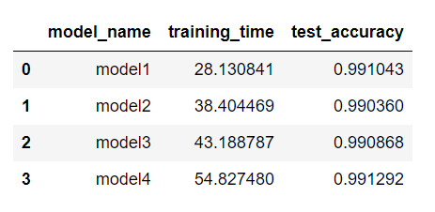
CNN Model Comparison

Slide 9
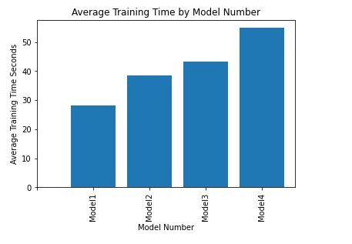
CNN Model Training Time

